Slide 1
Generic Functions
A generic function defines a general set of operations that will be applied to various types of data. The type of data that the function will operate upon is passed to it as a parameter
A single general procedure can be applied to a wide range of data

Slide 2
Generic Functions
A generic function is created using the keyword template
A generic function is also called a template function

Slide 3
Templates in C++
Templates are the foundation of generic programming, which involves writing code in a way that is independent of any particular type.
Templates are powerful features of C++ which allows you to write generic programs. A template is a blueprint or formula for creating a generic class or a function.
In simple terms, you can create a single function or a class to work with different data types using templates.
Templates are often used in larger codebase for the purpose of code reusability and flexibility of the programs.

Slide 4
What is the difference between function overloading and templates?
Both are used to achieve Compile time Polymorphism
Both function overloading and templates are examples of polymorphism feature of OOP. Function overloading is used when multiple functions do similar operations, templates are used when multiple functions do identical operations. You can use overloading when you want to apply different operations depending on the type. Templates provide an advantage when you want to perform the same action on types that can be different

Slide 5
Types
The concept of templates can be used in two different ways:
Function Templates
Class Templates

Slide 6
Generic Functions/Function Templates
A function template works in a similar to a normal function, with one key difference.
A single function template can work with different data types at once but, a single normal function can only work with one set of data types.
Normally, if you need to perform identical operations on two or more types of data, you use function overloading to create two functions with the required function declaration.

Slide 7
A function template starts with the keyword template followed by template parameter/s inside < > which is followed by function declaration.
template <class T>
T someFunction(T arg)
{
... .. ...
}

Slide 8
Generic Functions/Function Templates
You can write both statements in a single line:
template <class T> ret-type func-name(parameters)
{
// body of function
}
T is a placeholder that the compiler will automatically replace with an actual data type

Slide 9
You can also use keyword typename instead of class in the above example.
template <typename T>
T someFunction(T arg)
{
... .. ...
}

Slide 10
How to call a function template?
We can call the template function a couple of ways. Firstly, we can call it by explicitly specifying the type like so
//Explicit type parametrizing.
int myint = 5;
someFunction<int>(myint);
double mydouble = 99.9;
someFunction<double>(mydouble);

Slide 11
Implicit type parametrizing
However with template function the compiler can determine the parametrizing types when we don't provide them, hence we can also call someFunction() like so
int myint = 5;
someFunction() <>(myint);

Slide 12
Implicit type parametrizing
double mydouble = 99.9;
someFunction(mydouble);
The first call with empty angle brackets tells the compiler that we are calling a template function and the second call leaves it up to the compiler to infer.

Slide 13
Example
template <class X> void SimplePrint (X a)
{
cout << “Parameter is: ” << a;
}
int main()
{
int i = 20; char c = ‘M’; float f = 5.5;
SimplePrint ( i ); SimplePrint ( c ); SimplePrint ( f );
}

Slide 14
template <class T> void swapargs(T a, T b)
{
T temp;
temp = a;
a = b;
b = temp;
}
int main()
{
int i=10, j=20; double x=10.1, y=23.3; char a='x', b='z';
swapargs(i, j); // swap integers
swapargs(x, y); // swap floats
swapargs(a, b); // swap chars
}

Slide 15
Example
template <class T> void swapargs(T &a, T &b)
{
T temp;
temp = a;
a = b;
b = temp;
}
int main()
{
int i=10, j=20; double x=10.1, y=23.3; char a='x', b='z';
swapargs(i, j); // swap integers
swapargs(x, y); // swap floats
swapargs(a, b); // swap chars
}

Slide 16
Syntax
The line:
template <class X> void swapargs(X &a, X &b)
can also be written in two consecutive lines as:
template <class X> void swapargs(X &a, X &b) { \\ function body }
Note: But no other statement can occur between the two
lines

Slide 17
Function template with more than one type parameter
In above example you can only use single data type what if you want to use combination of data types
// 2 type parameters:
template<class T1, class T2>
void someFunc(T1 var1, T2 var2 )
{
// some code in here...
}

Slide 18
Function with Two Generic Types
You can define more than one generic data type in the template statement by using a comma-separated list
template <class T1, class T2> void myfunc(T1 a, T2 b) { cout << a << “ & ” << b << '\n'; }

Slide 19
Can you have unused type parameters?
No, you may not. If you declare a template parameter then you absolutely must use it inside of your function definition otherwise the compiler will complain. So, in the example above, you would have to use both T1 and T2, or you will get a compiler error.

Slide 20
Output?
#include <iostream>
using namespace std;
template <class T1, class T2>
void myfunc(T1 a){
cout << a << '\n';}
int main () {
myfunc(2);
return 0;
}

Slide 21

Output?

Slide 22

Output?

Slide 23
Output?
#include <iostream>
using namespace std;
template <class T1, class T2>
void myfunc(T1 a, T2 b)
{
cout << a << " & " << b << '\n';
}
int main () {
myfunc(3,4.5);
return 0;
}

Slide 24
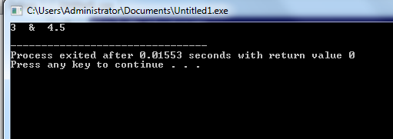
Output?

Slide 25
Function Templates-Generic Function
int main()
{
int i1, i2;
float f1, f2;
char c1, c2;
cout << "Enter two integers:\n";
cin >> i1 >> i2;
cout << Large(i1, i2) <<" is larger." << endl;
cout << "\nEnter two floating-point numbers:\n";
cin >> f1 >> f2;
cout << Large(f1, f2) <<" is larger." << endl;
cout << "\nEnter two characters:\n";
cin >> c1 >> c2;
cout << Large(c1, c2) << " has larger ASCII value.";
return 0;
}
This way, using only a single function template replaced three identical normal functions and made your code maintainable.
#include <iostream>
using namespace std;
// template function
template <class T>
T Large(T n1, T n2)
{
return (n1 > n2) ? n1 : n2;
}

Slide 26
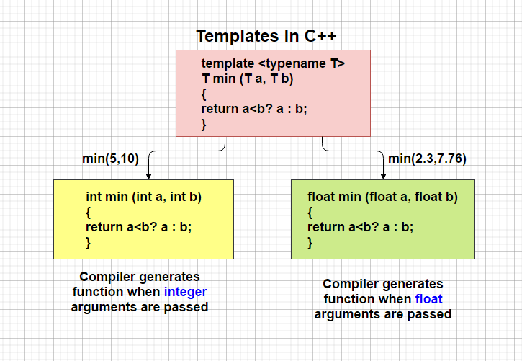
How templates work?

Slide 27
Use of Generic Functions
Generic functions are similar to overloaded functions except that they are more restrictive
When functions are overloaded, you may have different actions performed within the body of each function. But a generic function must perform the same general action for all versions

Slide 28
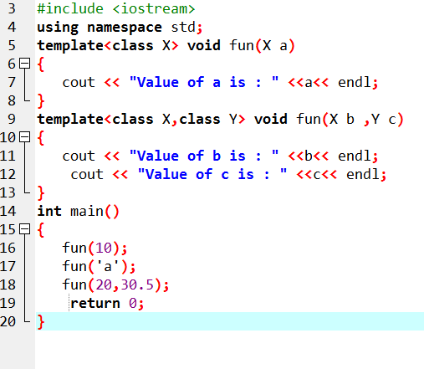
Overloading a Function Template

Slide 29
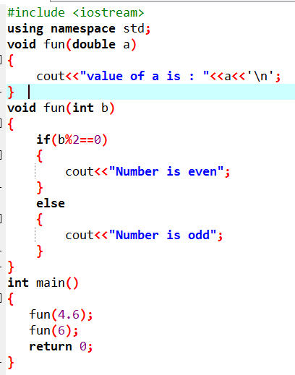
Restrictions of Generic Functions
Generic functions perform the same operation for all the versions of a function except the data type differs. Let's see a simple example of an overloaded function which cannot be replaced by the generic function as both the functions have different functionalities.

Slide 30
Class Templates-Generic Class
you can also create class templates for generic class operations.
Sometimes, you need a class implementation that is same for all classes, only the data types used are different.
Normally, you would need to create a different class for each data type OR create different member variables and functions within a single class.
This will unnecessarily bloat your code base and will be hard to maintain, as a change is one class/function should be performed on all classes/functions.
However, class templates make it easy to reuse the same code for all data types.

Slide 31
Generic Classes
In addition to generic functions, you can also define a generic class
The actual type of the data being used (in class) will be specified as a parameter when objects of that class are created
Generic classes are useful when a class uses logic that can be generalized e.g. Stacks, Queues

Slide 32
Generic Classes
The general form of a generic class declaration is shown here:
template <class T> class class-name
{
. . .
}

Slide 33
Generic Classes
If necessary, we can define more than one generic data type using a comma-separated list
We create a specific instance of that class using the following general form:
class-name <type> ob;

Slide 34
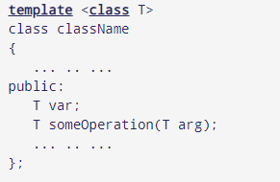
How to declare a class template?
In the above declaration, T is the template argument which is a placeholder for the data type used.
Inside the class body, a member variable var and a member function someOperation() are both of type T.

Slide 35
How to create a class template object?
className<dataType> classObject;
Example
className<int> classObject;
className<float> classObject;
className<string> classObject;

Slide 36
Example
template <class T>
class Calculator
{
private:
T num1, num2;
public:
Calculator(T n1, T n2){
num1 = n1;
num2 = n2;}
void displayResult(){
cout << "Numbers are: " << num1 << " and " << num2 << "." << endl;
cout << "Addition is: " << add() << endl;
cout << "Subtraction is: " << subtract() << endl;
cout << "Product is: " << multiply() << endl;
cout << "Division is: " << divide() << endl;}
T add() { return num1 + num2; }
T subtract() { return num1 - num2; }
T multiply() { return num1 * num2; }
T divide() { return num1 / num2; }
};
int main()
{
Calculator<int> intCalc(2, 1);
Calculator<float> floatCalc(2.4, 1.2);
cout << "Int results:" << endl;
intCalc.displayResult();
cout << endl << "Float results:" << endl;
floatCalc.displayResult();
return 0;
}

Slide 37
Example
template <class T1, class T2>
class myclass
{
T1 i;
T2 j;
public:
myclass (T1 a, T2 b) { i = a; j = b; }
void show( ) { cout << i << “ & ” << j; }
};

Slide 38
Example (cont.)
int main()
{
myclass<int, double> ob1(10, 0.23);
myclass<char, char *> ob2('X', “Hello”);
ob1.show(); // show int, double
ob2.show(); // show char, char *
}

Slide 39
Example Program of Class Template
template <class T>
class mypair {
T a, b;
public:
mypair (T first, T second)
{a=first; b=second;}
T getmax ();};
template <class T>
T mypair<T>::getmax (){
T retval;
retval = a>b? a : b;
return retval;}
int main () {
mypair <int> myobject (100, 75);
cout << myobject.getmax();
return 0;}

Slide 40
Using Non-Type Arguments with Generic Classes
In a generic class, we can also specify non-type arguments:
template <class T, int size> class MyClass
{
T arr[size]; // length of array is passed in size
// rest of the code in class
}

Slide 41
Example (cont.)
int main()
{
atype<int, 10> intob;
atype<double, 15> doubleob;
}

Slide 42
Using Non-Type Arguments with Generic Classes
Non-type parameters can only be of type integers, pointers, or references
The arguments that you pass to a non-type parameter must be an integer constant

Slide 43
Output?
template <class T ,int i>
class mypair {
T a, b;
public:
mypair ()
{a=0;
b=0;}
};
int main () {
int a=2;
mypair <int , a> myobject;
return 0;
}

Slide 44


Slide 45
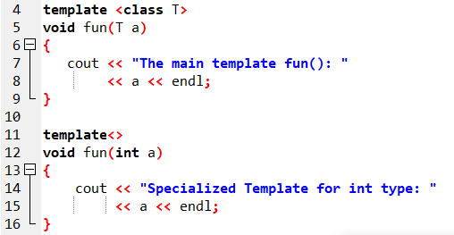
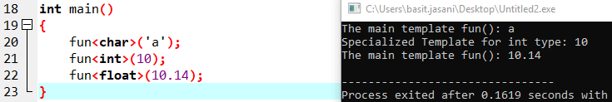
Specialized Template

Slide 46
Explicitly Overloading a Generic Function/Specializing templates
We can explicitly overload a generic function
If you overload a generic function, that overloaded function "hides" the generic function relative to that specific version
This is formally called explicit specialization

Slide 47
Example
template <class X> void func (X a) { cout << “Hello every data type: ” << a; }
// Following version hides generic version if parameter is int
void func (int a) { cout << “Hello integers: ” << a; }

Slide 48
Explicitly Overloading a Generic Function/Specializing templates
Normally when we write a template class or function we want to use it with many different types, however sometimes we want to code a function or class to make use of a particular type more efficiently this is when we use a template specialization. To declare a template specialization we still use the template keyword and angle brackets <> but leave out the parameters like so.
template<>

Slide 49
Alternate Syntax
A new-style syntax can also be used to denote the explicit specialization of a function:
template < > void func <int> (int a) { cout << “Hello integers: ” << a; }

Slide 50
Alternate Syntax
template < > void func (int a) { cout << “Hello integers: ” << a; }

Slide 51
Overloading a Generic Function
In addition to creating explicit, overloaded versions of a generic function, you can also overload the template specification itself
To do so, simply create another version of the template that differs from any others in its parameter list

Slide 52
Example
// First version of f() template
template <class X> void f(X a)
{
cout << "Inside f(X a)";
}
// Second version of f() template
template <class X, class Y> void f(X a, Y b)
{
cout << "Inside f(X a, Y b)";
}
int main()
{
f(10); // calls f(X) f(10, 20); // calls f(X, Y)
}

Slide 53
Using Normal Parameters in Generic Functions
You can mix non-generic parameters with generic parameters in a template function:
template<class X> void func(X a, int b)
{
cout << “General Data: ” << a;
cout << “Integer Data: ” << b;
}

Slide 54
Explicit Class Specializations
Just like generic functions, we can also create an explicit specialization of a generic class
To do so, use the template<> construct

Slide 55
Explicit Class Specializations
For other data types:
template <class T> class myclass { //… };
For integers:
template <> class myclass<int> { //… };

Slide 56
Specializing class templates
template <> class mycontainer <char> { ... };
First of all, notice that we precede the class template name with an empty template<> parameter list. This is to explicitly declare it as a template specialization. But more important than this prefix, is the <char> specialization parameter after the class template name. This specialization parameter itself identifies the type for which we are going to declare a template class specialization (char). Notice the differences between the generic class template and the specialization:

Slide 57
template <class T>
class Test
{
public:
Test(){
cout << "General template object \n";}
};
template <>
class Test <int>{
public:
Test(){
cout << "Specialized template object\n";}};
int main(){
Test<int> a;
Test<char> b;
Test<float> c;
return 0;}

Slide 58
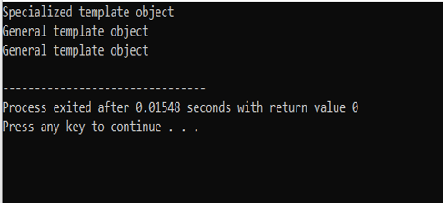

Slide 59
explicit specialization of a generic class only takes 1 type
#include <iostream>
using namespace std;
template <class T>
class Test
{
public:
Test(){
cout << "General template object \n";}
};
template <>
class Test <int,char>{
public:
Test(){
cout << "Specialized template object\n";}};
int main(){
Test<int , char> a;
Test<float> c;
return 0;}

Slide 60
Template specialization for multiple types
#include <iostream>
using namespace std;
template <class T , class V>//take 2 placeholder for multiple types
class Test
{
public:
Test(){
cout << "General template object \n";}
};
template <>
class Test <int,char>{
public:
Test(){
cout << "Specialized template object\n";}};
int main(){
Test<int , char> a;
Test<float , short> c;
return 0;}

Slide 61
Another possibility with 2 specialized classes
#include <iostream>
using namespace std;
template <class T>
class Test
{
public:
Test(){
cout << "General template object \n";}
};
template <>
class Test <int>{
public:
Test(){
cout << "Specialized1 template object\n";}};
template <>
class Test <char>{
public:
Test(){
cout << "Specialized2 template object\n";}};
int main(){
Test<int> a;
Test<char> c;
return 0;}

Slide 62
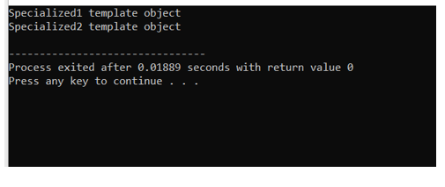

Slide 63
Common Applications
Stack
Queue
Other data structures

Slide 64
Next Lecture
STL!

